Slide 1
Multi-channel regression for plant trait prediction
Group 46
Goh Siow Chuen A0038678M/ Eka Buyung Lienadi A0161363L/
David Lee Kwok Hung A0168625W

Slide 2
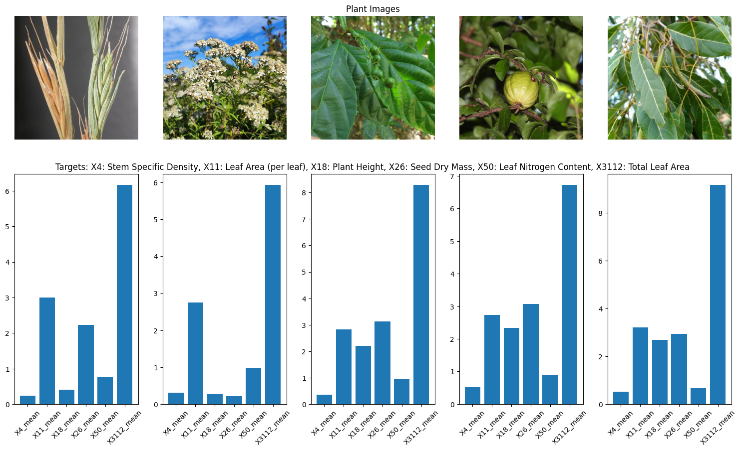
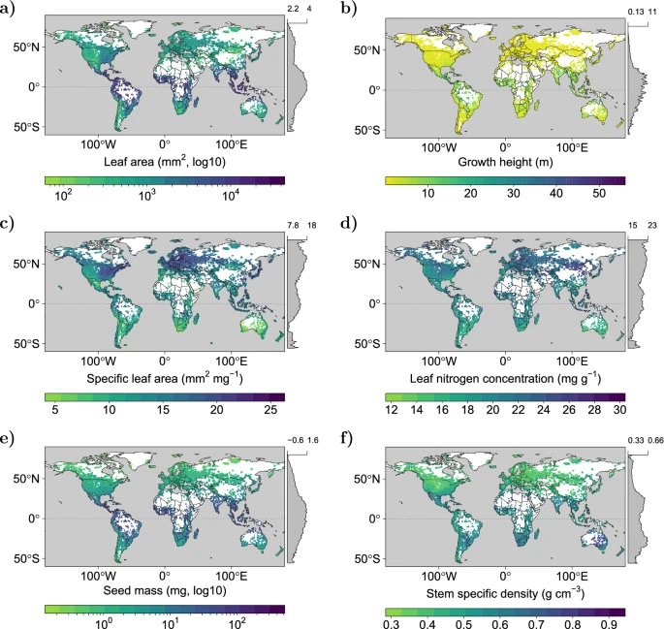
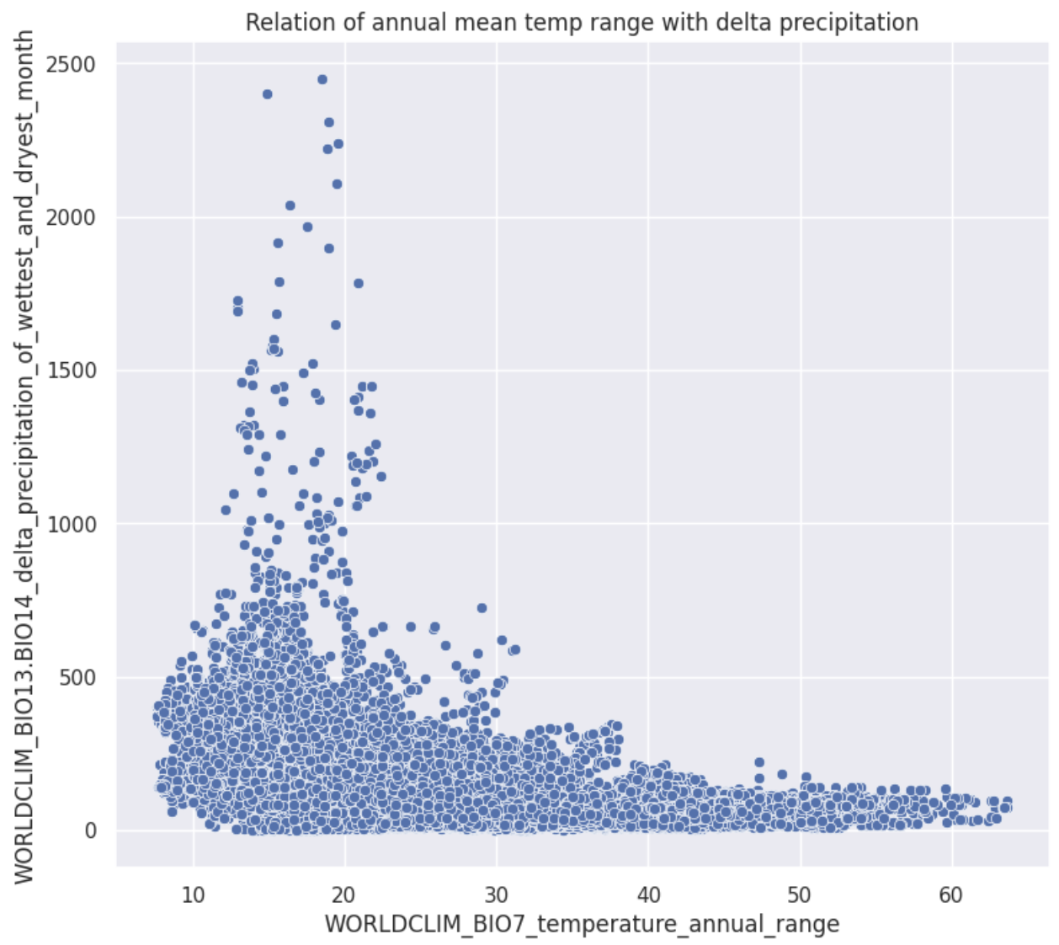
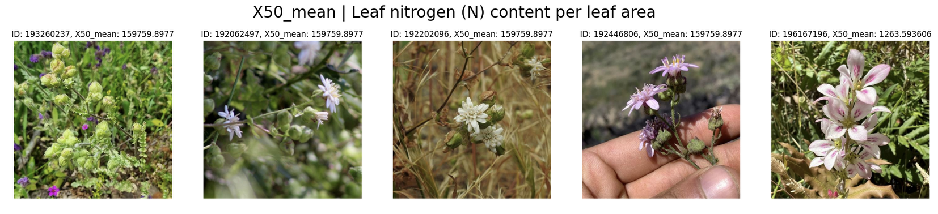
Plant photos can be used to predict plant traits
Plant traits are crucial for understanding ecosystems and their responses to factors like climate change, impacting diversity and productivity. [1]
Citizen science photos hold valuable data on plant species, appearance, and location, with over 20 million images available spanning various ecosystems globally. [2]
Current datasets lack integration of plant traits with images, hindering the understanding of how traits manifest visually. However, research linking the two data types showed that basic CNN models could be used to predict plant traits from photos. [3]
Goal: Predict 6 plant traits from image and tabular data
Tabular Data Analysis: Plant traits are correlated to geography
Dataset Properties: 69362 images with tabulated data in 80/20 train/test split
Data | Type, Size/Entry | Source
WORLDCLIM: Temperature and Precipitation data | Tabular Geodata, 6x1 | WorldClim global climate dataset [4]
SOIL: Global soil properties. Bulk density, clay proportion, carbon density, etc. | Tabular Geodata, 61x1 | ISRIC SoilGrids2 dataset [5]
MODIS: Satellite data measuring optical reflectance of sunlight | Tabular Geodata, 60x1 | MODIS/Terra Surface Reflectance dataset [6]
VOD: Radar data sensitive to water content and plant biomass | Tabular Geodata, 36x1 | VODCAv2 Vegetation Optical Depth Climate Archive [7]
Plant Traits: Leaf Area, Growth Height, Specific Leaf Area, Leaf Nitrogen, Seed mass, Stem specific density | Tabular Plant species data, 12x1 | TRY plant trait database [8]
Plant Photographs with geolocation and species name | Image, 512x512x3 | iNaturalist database [9]
Outliers: Issues with image quality (cropped, distorted, blur)

Slide 3
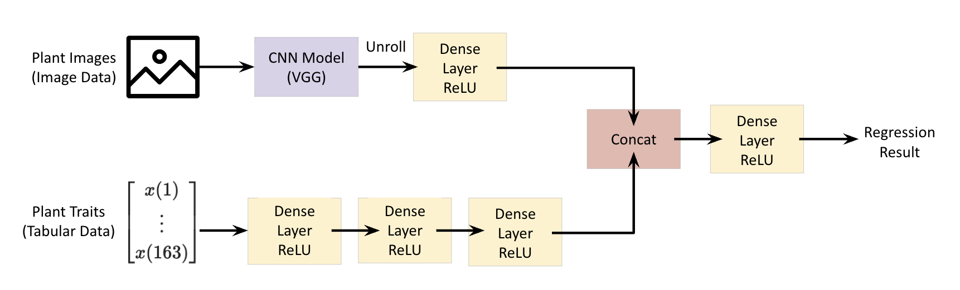
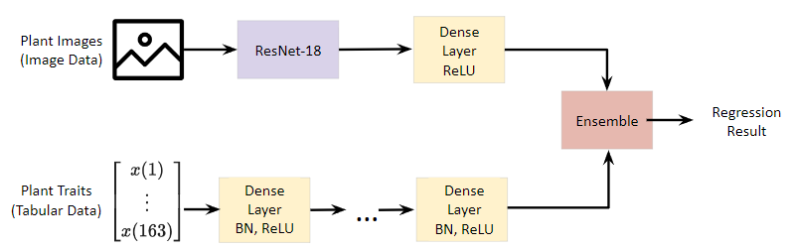
Methodology
Multi-class learning: We construct the model to predict 6 plant traits simultaneously to enable the model to capture relations between different plant traits
Multi-modal ensemble learning: In our dataset, besides climate data, additional predictors are also used, such as soil information, and optical and radar satellite data. We use both the plant image (trained using a CNN) as well as a vector combining the tabular data (trained using MLPs) to predict plant traits.
Approach 1: CNN (unroll) + tabular data -> MLP
Since there are two data types, we use CNN to extract the representation in image, then combined with the tabular data to produce regression result.
Custom Dataset required during training
Approach 2: CNN ResNet-18(image) and MLP (tabular) -> ensemble by weighted average
Residual / shortcut connection in ResNet enables the gradient to propagates several layers deeper, allowing a deeper network.
Ensemble to tune overall prediction by leveraging the learning from both CNN and MLP model.

Slide 4
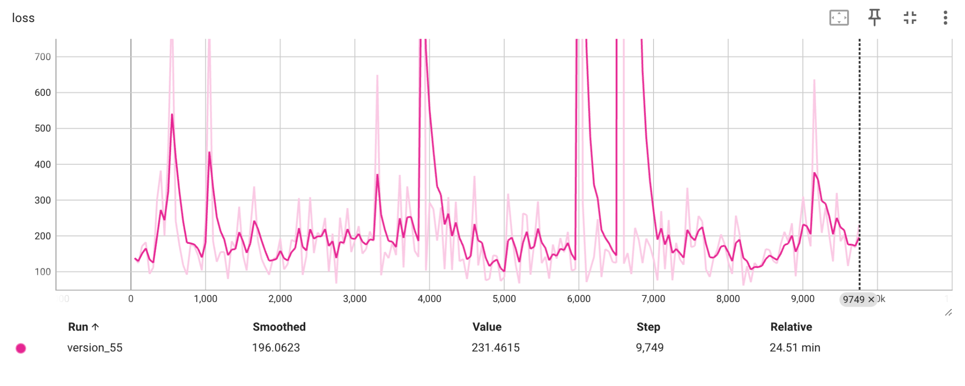
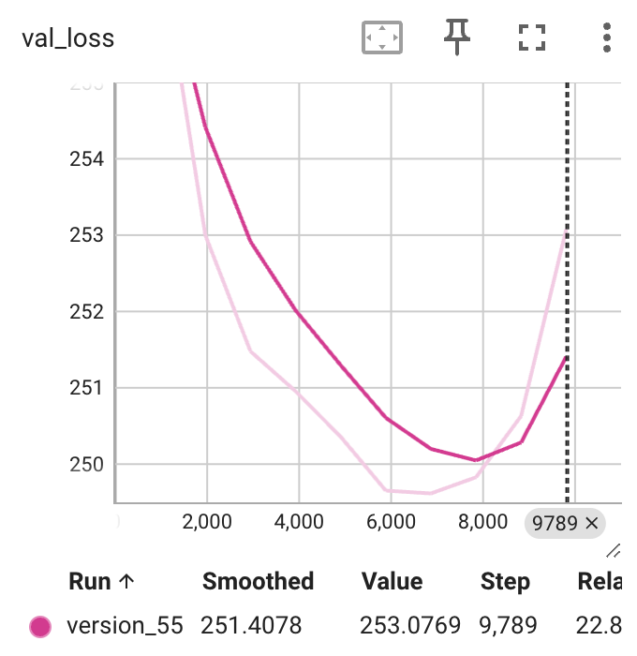
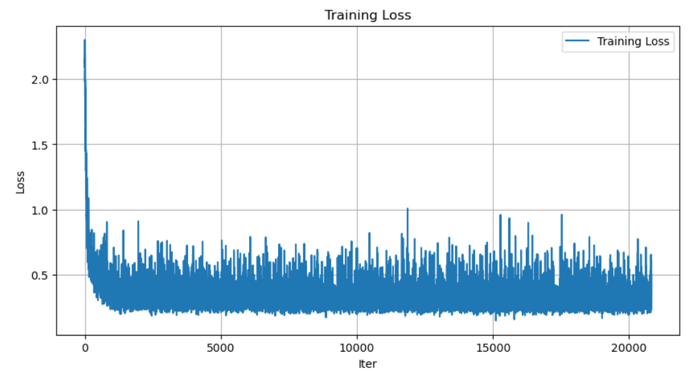
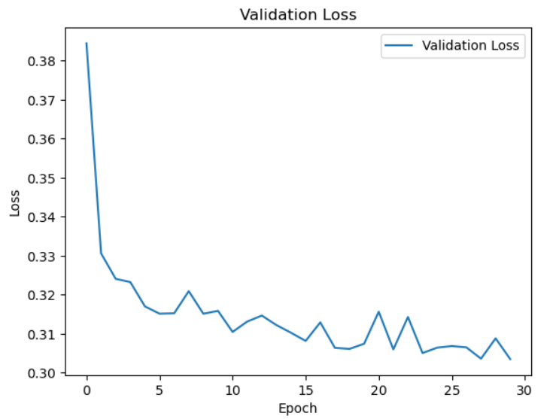

Results and Evaluation
Training/validation loss function
L2-norm loss function is selected given this is a regression problem.
Evaluation Metric
We use R² (Coefficient of Determination) to measure the performance of the model.
Key Takeaways
Approach 1 observed to better in predicting the plant traits given the higher R² score.
This is likely because the final MLP layers concurrently learn from both image (CNN-VGG output) and tabular data, enabling the model to better capture patterns from both datasets simultaneously.
Work In Progress
Use more advanced image prediction models such as ViT architectures with tabular data.
Hyperparameter tuning on learning rate, separate early stopping for image and tabular pipelines
Approach 1
Approach 2
Training loss
Validation loss
Training loss
Validation loss

Slide 5
Q&A
Thank You For Your Kind Attention

Slide 6
References:
[1] Madani, N., Kimball, J.S., Ballantyne, A.P. et al. Future global productivity will be affected by plant trait response to climate. Sci Rep 8, 2870 (2018). https://doi.org/10.1038/s41598-018-21172-9
[2] Wolf, S., Mahecha, M.D., Sabatini, F.M. et al. Citizen science plant observations encode global trait patterns. Nat Ecol Evol 6, 1850–1859 (2022). https://doi.org/10.1038/s41559-022-01904-x
[3] Schiller, C., Schmidtlein, S., Boonman, C. et al. Deep learning and citizen science enable automated plant trait predictions from photographs. Sci Rep 11, 16395 (2021). https://doi.org/10.1038/s41598-021-95616-0
[4] Fick, S.E. and Hijmans, R.J. (2017), WorldClim 2: new 1-km spatial resolution climate surfaces for global land areas. Int. J. Climatol, 37: 4302-4315. https://doi.org/10.1002/joc.5086
[5] Poggio, L., de Sousa, L. M., Batjes, N. H., et al. (2021), SoilGrids 2.0: producing soil information for the globe with quantified spatial uncertainty, SOIL, 7, 217–240, https://doi.org/10.5194/soil-7-217-2021
[6] Vermote, E. (2021). MODIS/Terra Surface Reflectance 8-Day L3 Global 500m SIN Grid V061 [Data set]. NASA EOSDIS Land Processes Distributed Active Archive Center. Accessed 2024-04-15 from https://doi.org/10.5067/MODIS/MOD09A1.061
[7] Zotta, R.-M., Moesinger, L., van der Schalie, R., Vreugdenhil, M., Preimesberger, W., Frederikse, T., De Jeu, R., & Dorigo, W. (2024). VODCA v2: Multi-sensor, multi-frequency vegetation optical depth data for long-term canopy dynamics and biomass monitoring (1.0.0) [Data set]. TU Wien. https://doi.org/10.48436/t74ty-tcx62
[8] Kattge, J., Bönisch, G., Díaz, S., Lavorel, S., Prentice, I. C., Leadley, P., Tautenhahn, S., Werner, G., et al. (2020). TRY plant trait database - enhanced coverage and open access. Global Change Biology, 26(1), 119-188. https://doi:10.1111/gcb.14904
[9] iNaturalist. Available from https://www.inaturalist.org. Accessed 15 April 2024

